Slide 1


Company Name
Slowey McManus/Emerging BioCommunications
Life Sciences Capabilities Overview
June 2024

Slide 2
Who We Are
Slowey McManus/Emerging BioCommunications is a full-service communications firm offering a wide range of services, including business-to-business communications, business-to-consumer communications, media relations, crisis communications, social media strategy and management, website content development and administration, trade show support, writing and media training.
SMC has a deep bench of experienced professionals serving a wide range of organizations in New England, across the country and globally. The firm’s clients include Walmart, the world’s largest retail chain, several leading healthcare companies and an array of healthcare, life sciences, medical technology, and energy companies, as well as nonprofits.
We’ve developed successful public relations campaigns for hospitals and health care providers, national emergency responders, medical device companies, and innovative startups developing AI-based services, breakthrough therapeutics, and new treatment modalities. We’ve managed repositioning campaigns, product launches, crisis communications, adverse event reports and major legal decisions.

Slide 3
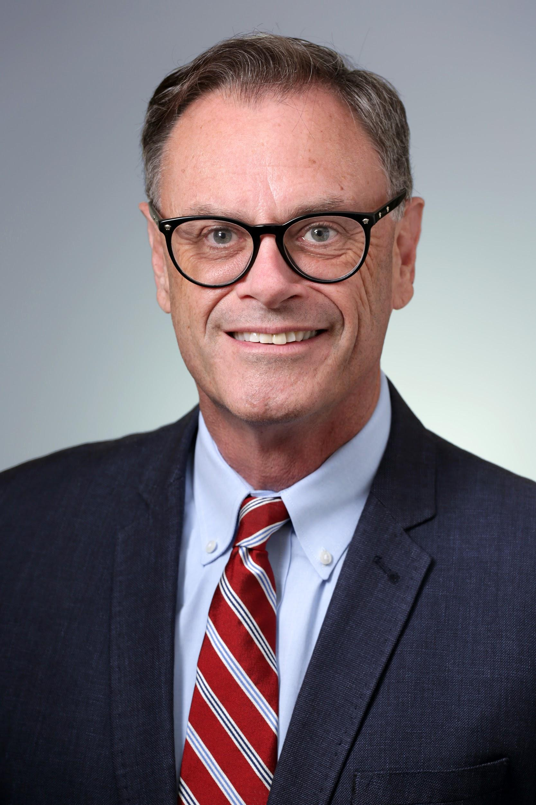
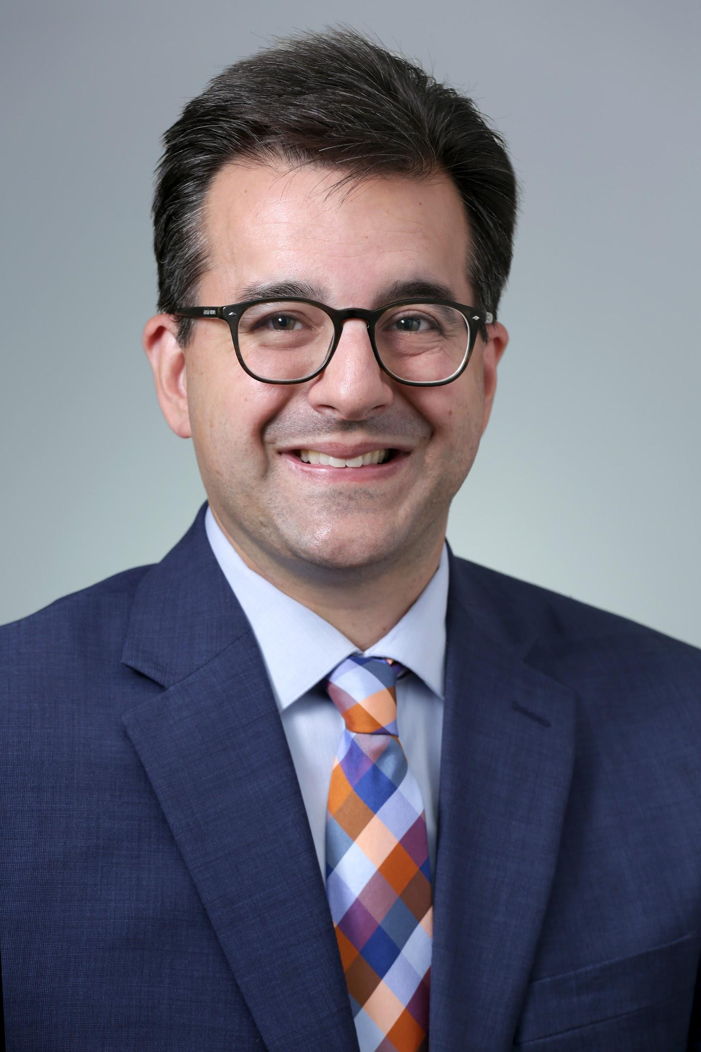
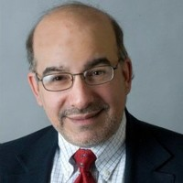
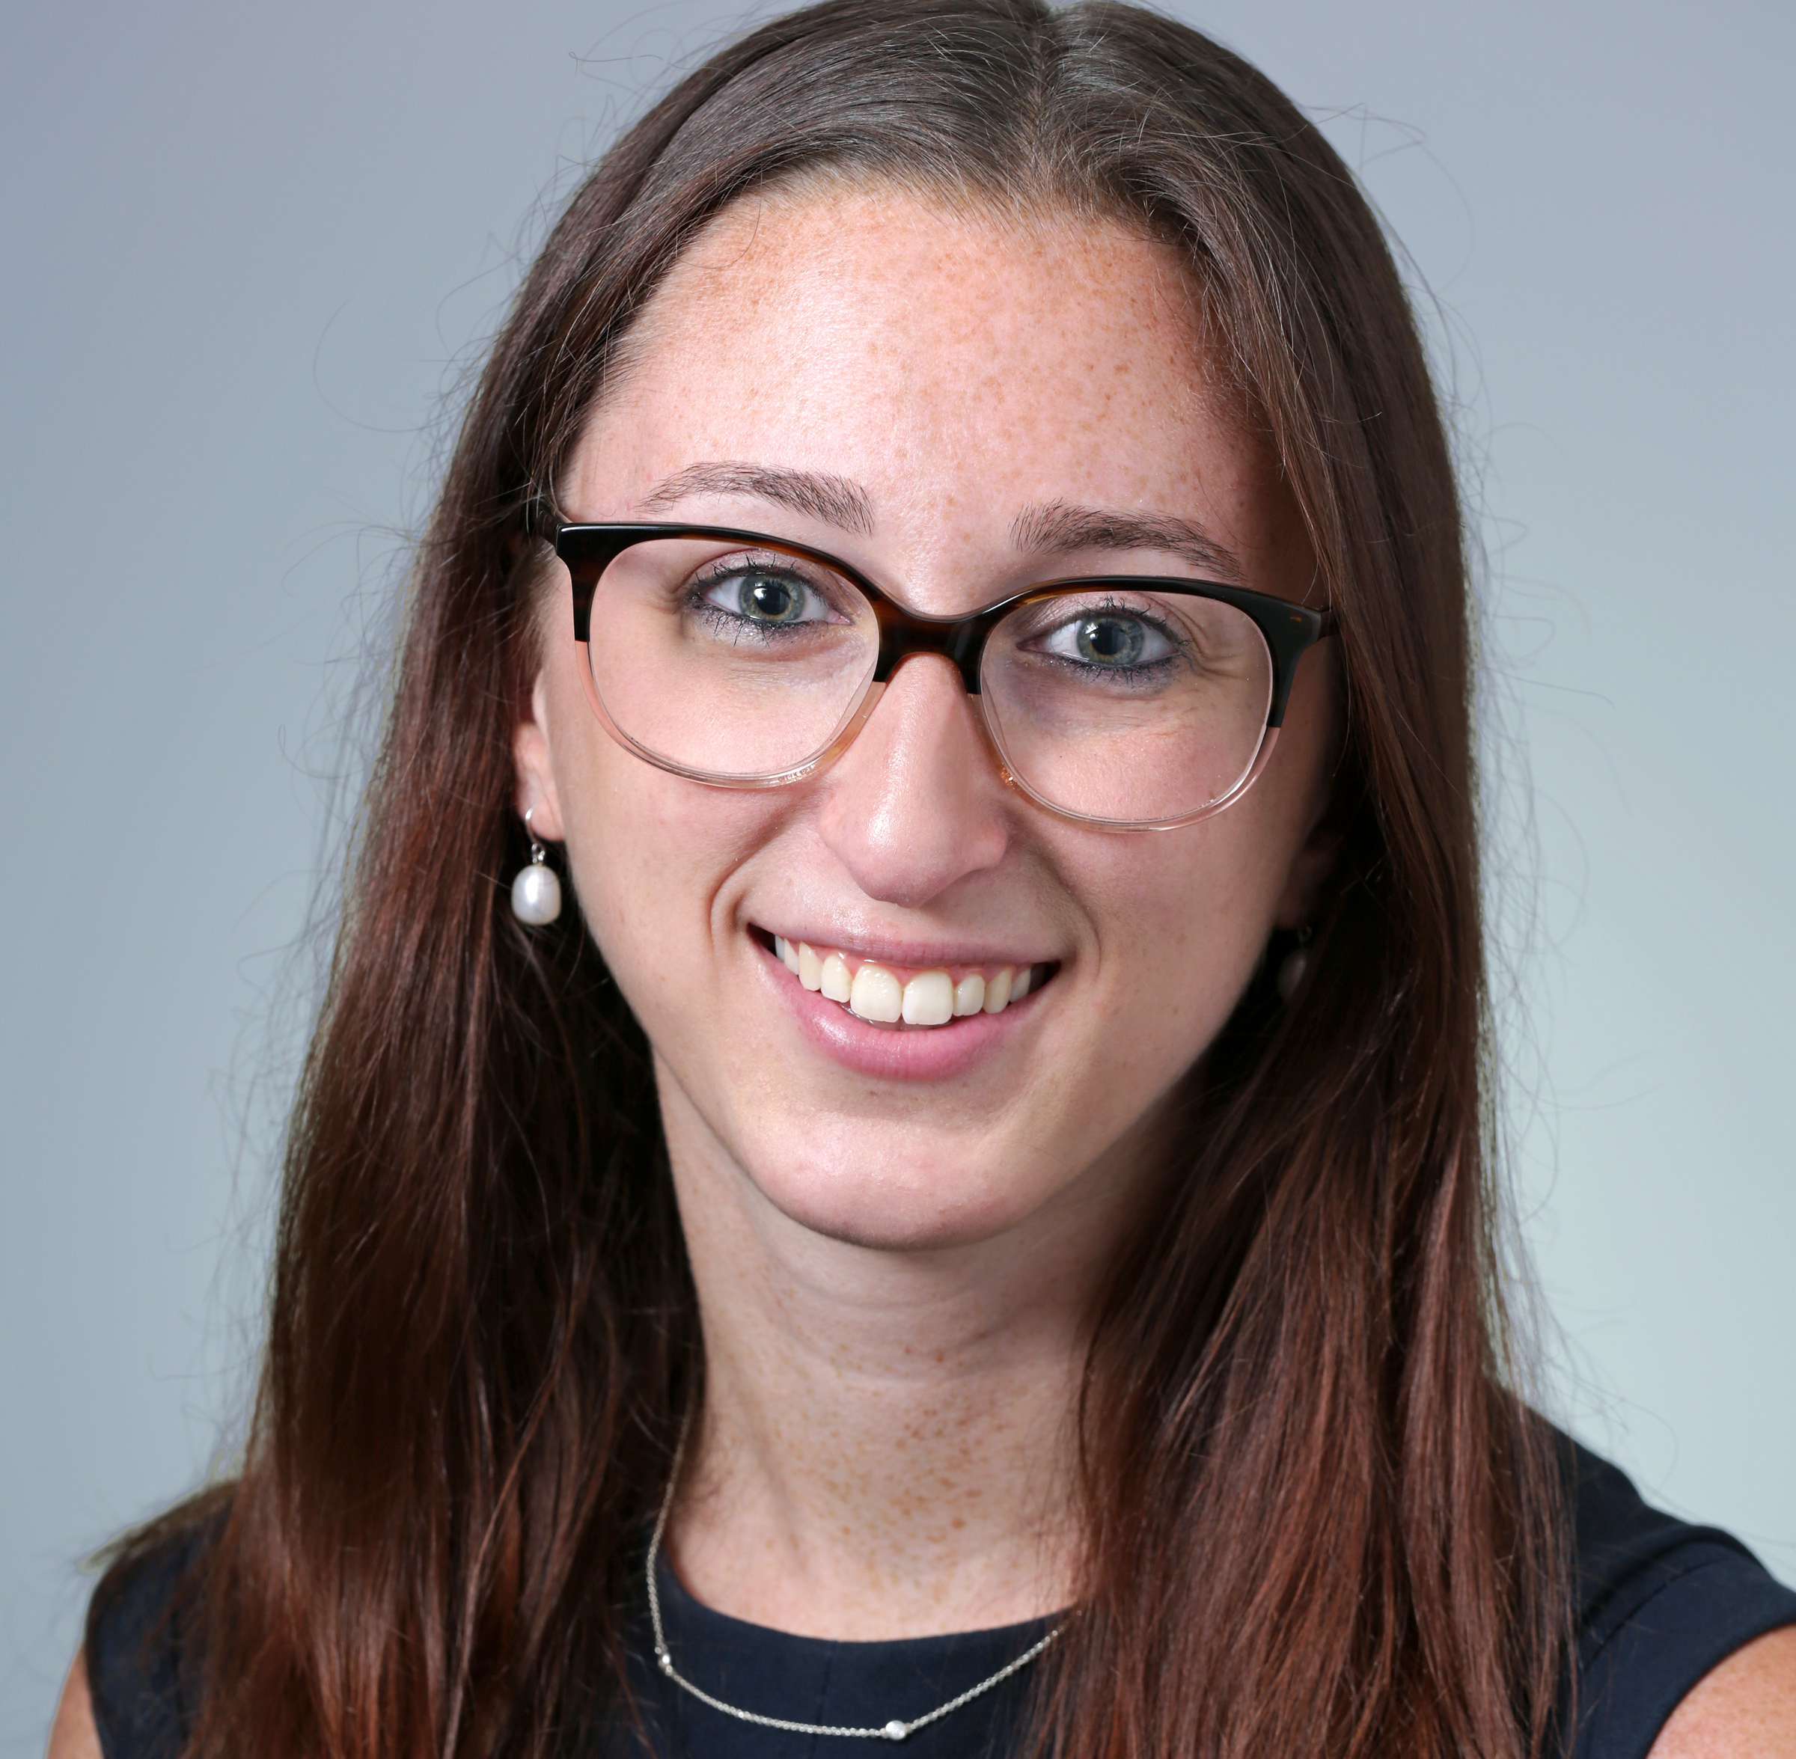
About Us
Boston-based strategic communications firm with national reach that offers:
Strong expertise in healthcare, life sciences, behavioral health, corporate and public policy sectors.
A creative and collaborative team that excels at thought leadership campaigns and telling stories that cut through the clutter.
Excellent relationships with the media that secure consistent placements in print, broadcast, and online coverage with national, regional, local and trade media.
A fully integrated firm with strong capabilities in strategic communications, public relations, digital strategy, multimedia and executive communications training.
Jim McManus
Travis Small
Jeffrey Krasner
Abby Silverman

Slide 4
What makes us different
Our senior staff is always involved in the day-to-day client management and creative work.
We build long-term partnerships with our clients.
Our team brings diverse and complementary skills to keep pace with the changing media environment.
We believe the best communicators are the smartest, not the loudest. We work with clients to communicate strategically and earn attention.

Slide 5
A Broad Array of Capabilities
Messaging & Strategic Communications | Training & Spokesperson Preparation
Communications Planning Communications & Competitive Audits Messaging & Platform Development Narrative Creation Positioning Statements Vision & Mission Statements Elevator Pitches Fact Sheets and Material Development | Messaging Training Media Training & Executive Team Preparation Spokesperson 1:1 Training & Mock Interviews Crisis Communication Protocol and Scenario Training Speaker and Presentation Training Investor / Earnings Call Preparation
Public & Media Relations | Digital Strategy & Multimedia
Proactive Outreach Rapid Response Press Release & News Pipeline Thought Leadership Programs Editorial Strategy Contributed Article & Op-ed Creation Media Training Event & Conference Support Speech & Presentation Writing | Web Content Development Social Media Management Digital Campaigns & Boosted Content Videography & Multimedia Video production Email Marketing & Newsletters Blog & Digital Content Creation Asset Development Collateral and Fact Sheets Visuals and Infographics

Slide 6















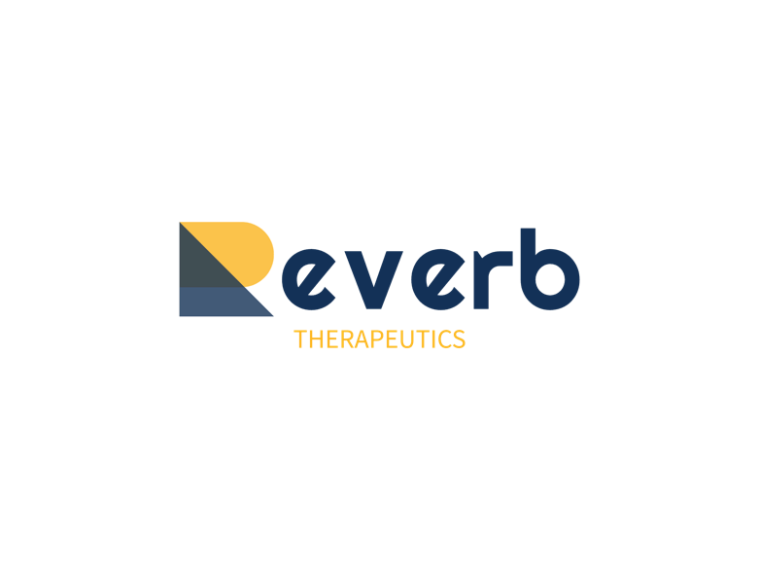




Recent life science engagements

Slide 7
Our Approach
Building an Integrated Campaign
Understand your business objectives, clinical milestones, and financial catalysts
Learn from existing research on the subject matter
Review current therapeutic landscape of new and innovative treatments
Business Model
Life Sciences Landscape
Analyze the needs of the different audiences you are trying to reach; Explore who can be influenced
Audience Analysis
Assess and target relevant media and leverage our relationships
Existing Research Audit
Media Targets
Review existing clinical research and competitive firms
7
7
Notes:
Phase 1 Focus & Priorities
Given our experience, collective track record and the team that we have assembled, we won’t need a significant ramp-up time to learn about Conformis or the market for orthopedic knee and hip replacement.
As we noted in our proposal, we will use the first phase to work with you to structure a fully integrated campaign that aligns with your business goals & priorities.
During and following our kick-off meeting, we’ll dive right into the following:
Business Model: Again, we’ll take the time to fully understand your business model, objectives and milestones. We’ll build our integrated work plan to support this.
TJR & Surgical Landscape: We’ll get a better understanding of the trends in TJR and surgery. Looking at your recent ‘Post-Pandemic Recovery’ materials, it is also important that we understand the disruption that the pandemic has caused across healthcare, your business, but the opportunity for Conformis to tap into the ASC market and play a critical role in achieving pre-pandemic normalcy.
Audience Analysis: We will conduct a full audience analysis and mapping (this will be key, and we will work with the Conformis marketing and communications team to hone key messaging that will resonate with the media and other target audiences)
Existing Research: Rowan has already shared a wealth of information with us between case studies, patient & surgeon videos and your array of clinical studies. This will also help us hit the ground running.
Media Landscape: Finally, we have an extensive media list and strong media relationships that we’ll discuss shortly, but the key is to align with reporters where we have relationships and help get Conformis, your products and your approach on their radar.
We are excited to be considered as your potential partner during this critical time, and we are looking forward to rolling up our sleeves and getting to work.

Slide 8




Media Relations:
How We Achieve Consistent Media Placements
Kick-off, Ongoing ideation and brainstorming
Refining messaging and executive training
Proactive pitching:
News and milestone matrix
Storyjacking
with the Rapid Response Program
Integrated workplan for amplification of earned media
Notes:
Phase 1 Focus & Priorities:
As part of our early work together and kick-off session, it will set the stage for our ongoing media relations program.
To provide a regular cadence of new content, breaking news and organizational milestones, we’ll work with you to actively manage a news pipeline throughout the second phase and our ongoing work together. This will include an overview of anticipated press releases, stories and thought pieces as part of our work plan and activities calendar developed during the first phase of our engagement.
Media Relations – In addition to actively managing the Conformis news pipeline, we will build a robust media relations program. Our steady outreach to the media will build awareness and gain more positive attention for your business and the advantages of your knee and hip products among surgeons and patients. This will include both our proactive and rapid response programs as outlined.
Integrated Workplan – We’ll deliver this in the first phase and will maintain it as a working document to ensure that we are managing all our mapped PR opportunities together while being nimble enough

Slide 9

















Deep Media Relationships
Notes:
SMC has an extensive database of relevant media contacts to support our work with Conformis including national and regional reporters, healthcare and orthopedic industry trade press, and technology and innovation press (notably, healthtech and medtech media).
We will review your existing media list and use our database to update and add to it. We will work to identify new targets for earned media with a focus on geographic areas with aging populations and strong orthopedic practices, such as California, Florida and Texas.
We will leverage our strong media relationships to find receptive reporters. Finally, we will dedicate a member of our team to monitor relevant news impacting Conformis and joint replacement technologies and solutions.
Reporters to highlight:
STAT: Gideon Gil and Casey Ross, who is STAT’s national technology reporter
Business Insider’s new senior healthcare reporter, who came over from the BBJ: Allison DeAngelis
Fierce: Amirah Al Idrus and Conor Hale
MD+DI: Omar Ford and his team (many are freelancers these days)

Slide 10
How we work with our clients
sign-offs to ensure messaging consistency
program review and
next steps
frequent
phone & email contact
ongoing
strategic
counsel
timely reports and analytics
Notes:
Achieving and measuring results is not only something we do faithfully but is one of our guiding principles. We are driven in all our work for clients by a commitment to providing value. We engage, measure our collective success and report out in the following categories:
Regular Engagement & Reporting – We will track our work for the various activities mentioned above against our proposed work plan. Our communications plan will include monthly trackers to assess progress as well as a regular calls or meetings with your team.
Measuring Progress Against Business & Campaign Goals – Your reputation is only as good as your name. Behind our name are results – and achieving and measuring results is something we do faithfully. We are driven in all our work for clients by a commitment to providing value. We measure success by both qualitative and quantitative metrics that we establish from the outset with clients that closely align with their organizational goals.
Campaign Reports & Dashboards – Toward that end, we have developed a number of reports and dashboards to monitor campaign performance. One format that we implement with many clients is tracking quantitative measurements as total media impressions and qualitative measures that could include the location of the placement and a comparison to coverage of like organizations. These metrics are established during the kick-off meeting at the start of the engagement and are tailored to fit the needs of our clients and campaigns.

Slide 11

Thank You

